Slide 1
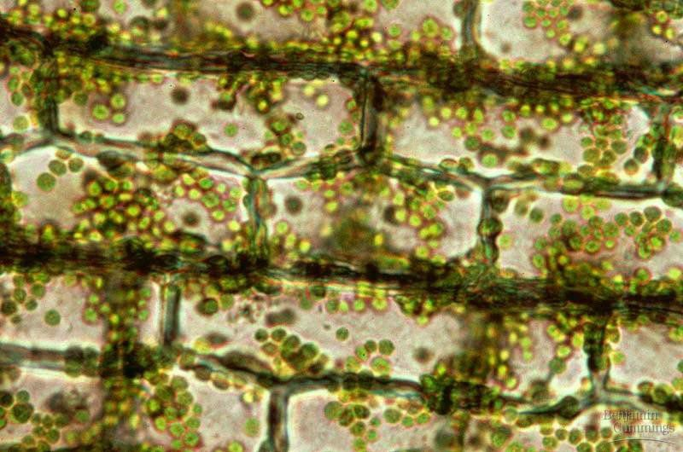
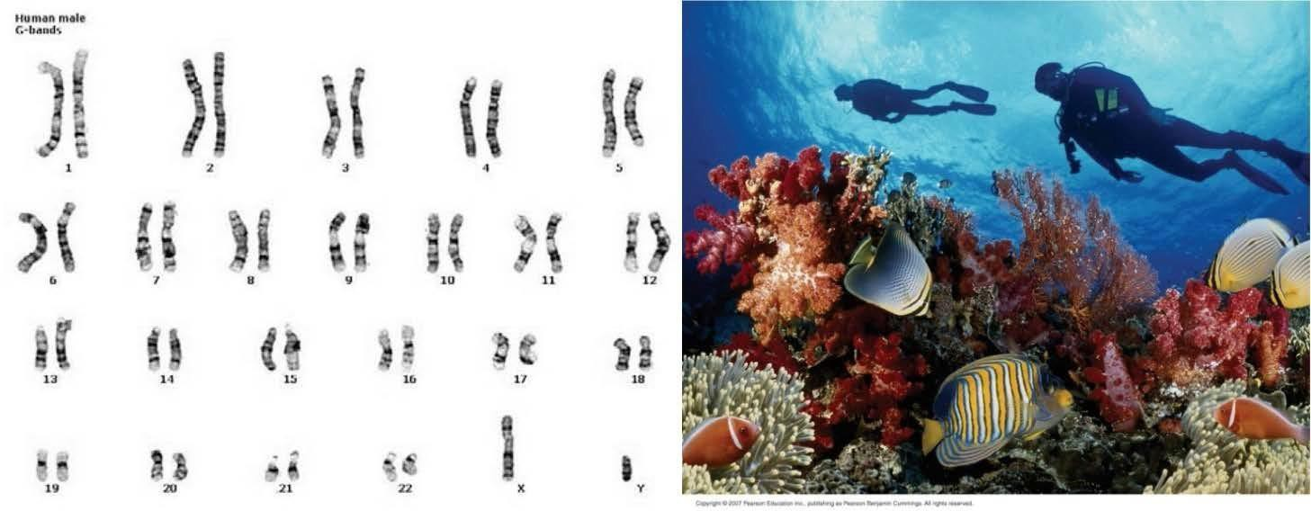

SLE 111 - CELLS AND GENES
Bioinformatics Assignment Instructions
Melbourne Institute of Business and Technology Pty Ltd trading as Deakin College CRICOS Provider Codes: Deakin College 01590J, Deakin University 00113B

Slide 2
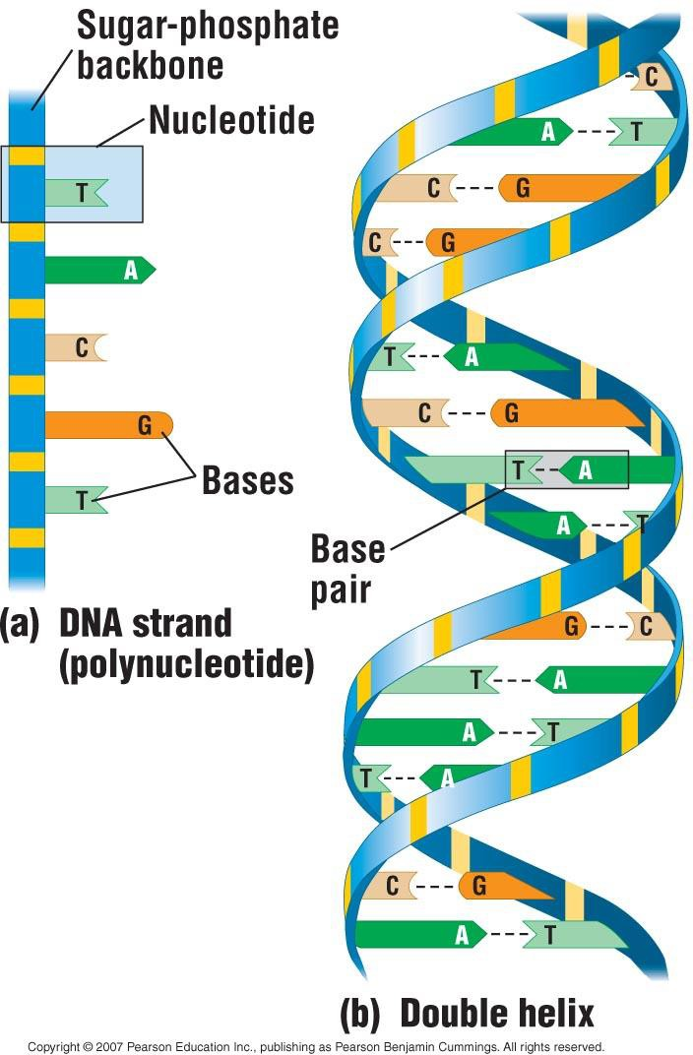
Revision - Nucleic Acids
DNA and RNA – built from nucleotides
Store and transmit information (genes)
Protein synthesis

Slide 3
The Structure of RNA
RNA differs from DNA in that it:
Has a different sugar in the chain (ribose)
Has one base different (uracil not thymine) – (U not T)
Is usually single stranded whereas DNA is usually double stranded
mRNA – Messenger RNA: carries the genetic information from the DNA to the ribosome

Slide 4
From DNA to RNA to Protein
Genetic information in DNA is transcribed into RNA and then translated into polypeptides.
What is the language of nucleic acids?
The linear sequence of nucleotide bases
DNA is transcribed into pre-mRNA
pre-mRNA is modified into functional mRNA
mRNA is translated into an amino acid polypeptide

Slide 5
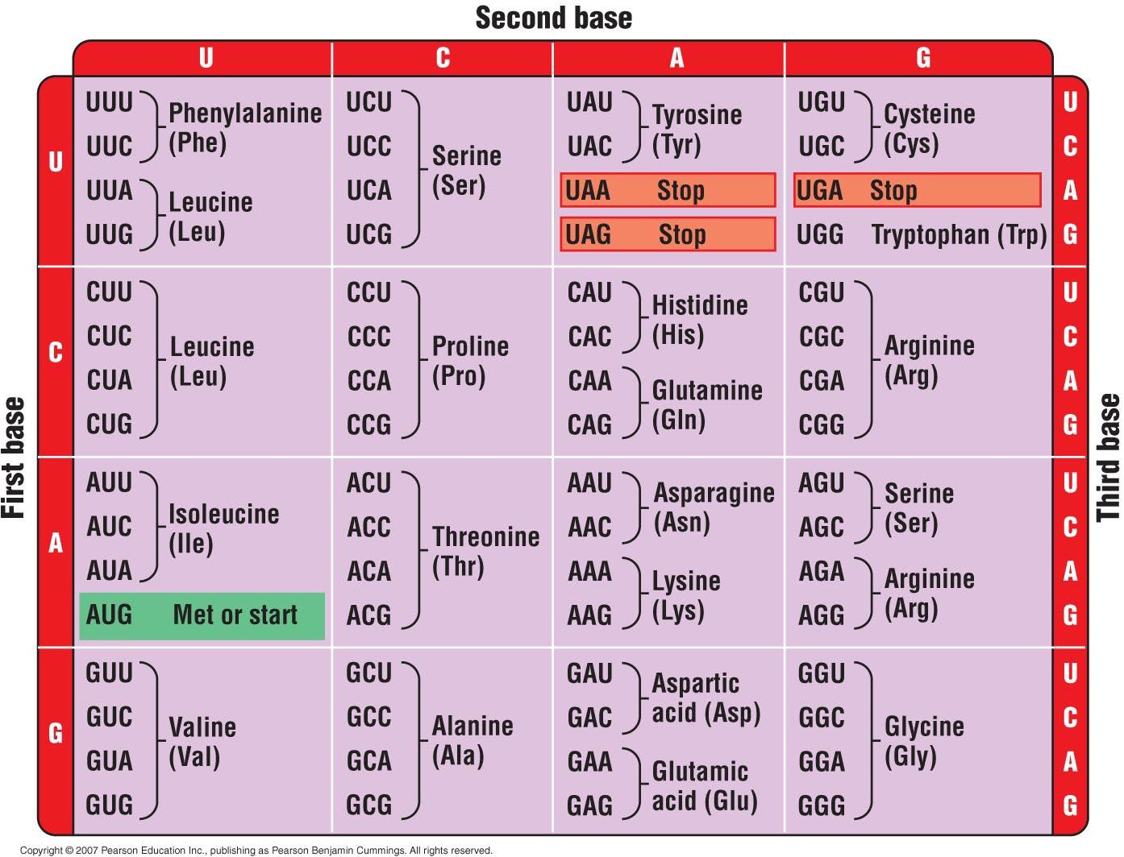

Slide 6
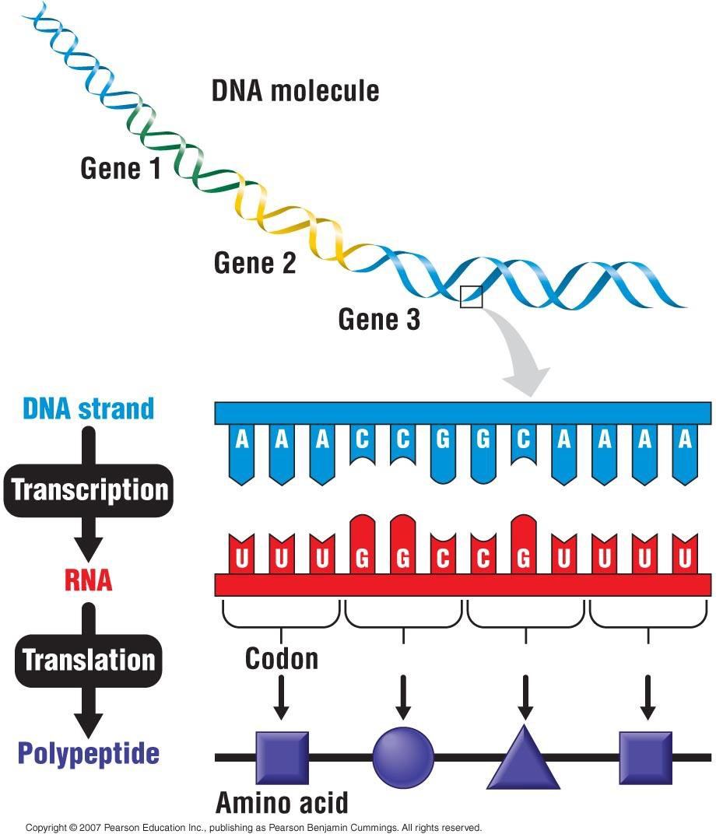

Slide 7
Bioinformatics
The use of computers, software and mathematical models to process and integrate biological information from large data sets.
This can include biological information such as:
nucleotides
whole genes
whole genomes
amino acids

Slide 8
Bioinformatics
With the advent of rapid whole genome sequencing there is an enormous amount of information in the central databases
The interpretation of this information is known as bioinformatics

Slide 9
Types of Data
Sequence Data is represented as a string of alphabetical characters
File formats for text files is FASTA

Slide 10
Types of Data
Nucleic Acids
5 Bases – A, T, G, C, and U
Unknown nucleic acids are represented by N
Base | Symbol
Adenine | A
Cytosine | C
Guanine | G
Thymine | T
Uracil | U

Slide 11
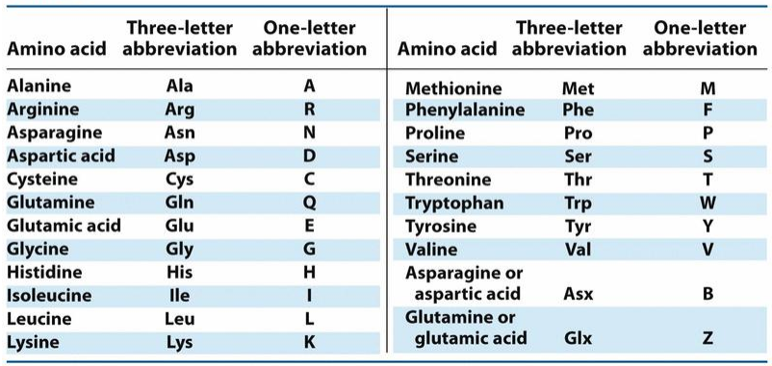
Types of Data
Proteins
20 amino acids – A, C, D, E, F, G, H, I, K , L , M , N, P, Q,R, S, T, V, W, Y
Unknown amino acids are represented by X
http://medical.mu.edu.iq/wp-content/uploads/2019/02/CHEM-1.-Amino-acids.pdf

Slide 12
The basics of BLAST
“The Basic Local Alignment Search Tool (BLAST) finds regions of local similarity between sequences. The program compares nucleotide or protein sequences to sequence databases and calculates the statistical significance of matches BLAST can be used to infer functional and evolutionary relationships between sequences”.

Slide 13
The basics of BLAST
BLAST has many uses but your job will be to take an unidentified, partial sequence and find out what the gene is, and where it comes from

Slide 14
Practise Sequence – Note this is NOT the one for the assignment!
CACGTGTTCCGGGAGGTAGACATGCGAGCGGACAAGATGTACCGCGTTCATGTGAGCAG GGTTGTTTTGGTACTGGTATGGGTTATGGCACGTTTTACGGTTTTTTCGTCGAGTCCGCAGC AGTTTCGGCAGAGCAGAAGGGAATGCTACGGTGCGATTAGGTTCGGACCTGTCGTGACG GAGACCCCGCTGCCTGTGGCCCCTGTTCGGCCTCGCCCTGTAGGTGTCGTACCTCGAGATT TACAACGAGCAACTGTACGACCTGCTGGGAGACACACCCGGGACCAGCGACGCGCTGGC AGTGCTGGAGGATTCAAACAGCAATACATACGTGAGCGCTAAACACTGATGGGTGGTTGA ACTCCTGTTGCAGTACGCGGCCCCCAGCTGGTGCTACCCCGCCACCACTCGCCCGACTGAG TGCGGTGTGCCTGCCACGTGGGTGTCTCGCACCTGCAGGTCCGCGGCCTGACGCTGGTGC CGGTGCGCAGCGAGGAGGAGGCGCTGGCGCAGTTCTTCCTGGGCGAGCAGGGCCGCAC CACTGCCGGACACGTGCTCAACGCGGAGAGCAGCCGCTCGCACACGGTGTTCACTATTCA CGTGGAGGTAAGCGAGTGCAGCACCTAAGCAAACTGAGCGCGTGGATGGGACTGAACGA AGGAGAGCGCTGGGTGGCAGGCGCCTCAAGAGTCAAGGCTCACGGGCGAGCTAGTGCA TCCTTGTTCGTGCCCGCCCCTCATCGTCTTTGTAGTGCTTTTCTTCAGTCCTGTATGTTCTGTA TCTGTGCGTGACATAGCACAGGCAGAAGGCATGGGTAGAAGGGCTTGACACATGTTGTTT AAGGGAAACCTGATGCTTGGGAA

Slide 15
Step by Step
Go to the National Centre for Biotechnology Information website
www.ncbi.nlm.nih.gov

Slide 16
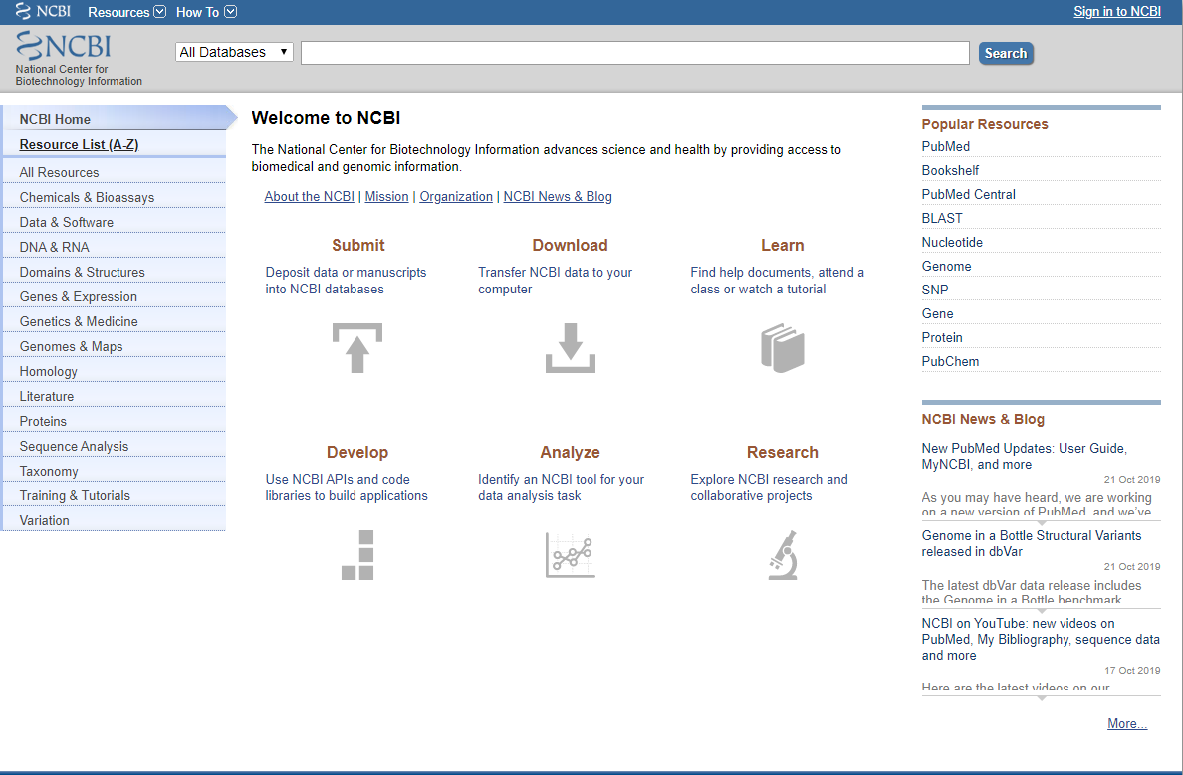
Within this site you will be using BLAST

Slide 17
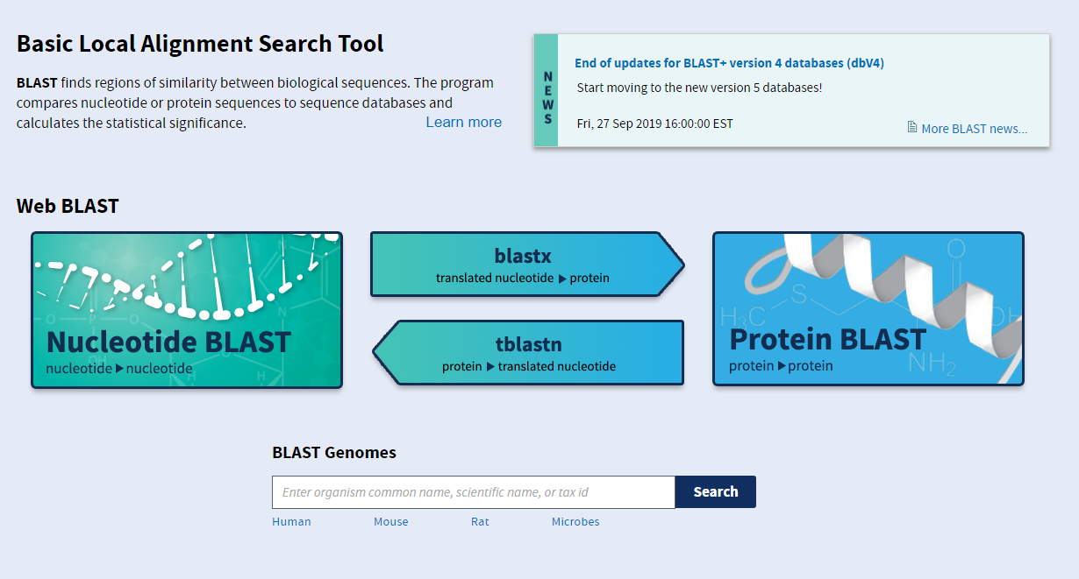
Go to BLAST page – you will note there are 4 search options
Nucleotide blast, Protein blast, Blastx, Tblastn
Choose the appropriate BLAST program between the first two
Do not choose Blastx, Tblastn

Slide 18
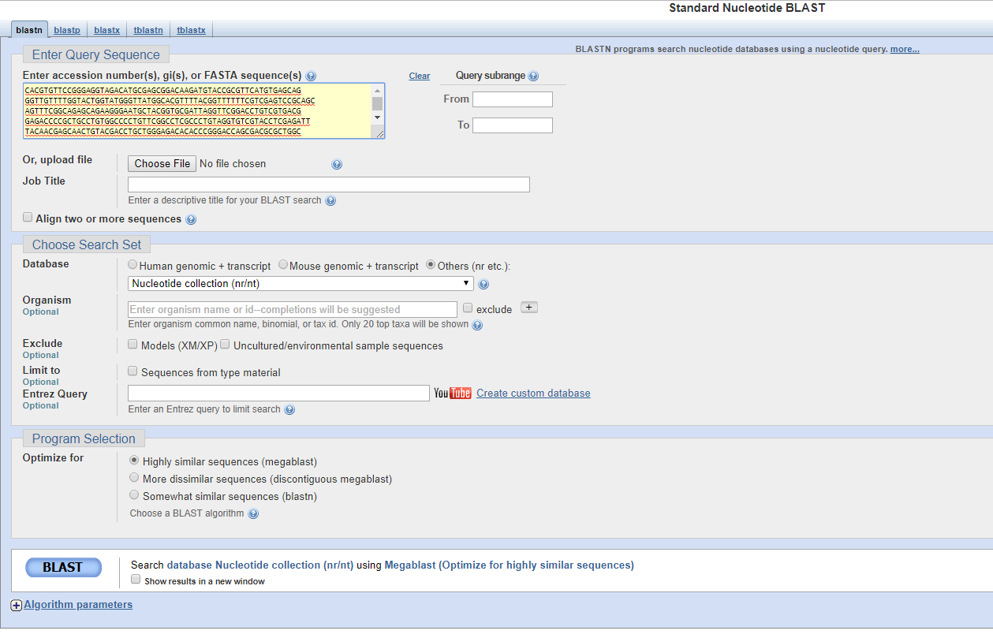
Paste sequence into box where it says “Enter Query Sequence”
Select others under “Choose Search Set”
Make sure the program is optimized for “highly similar sequences (megablast)”
Click BLAST
1
2
3
4

Slide 19
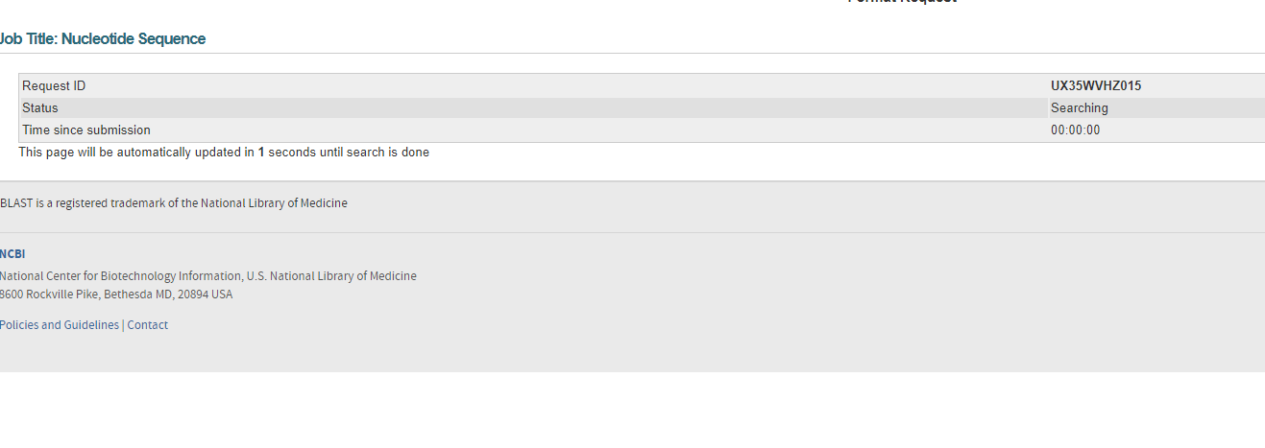
Then Wait……..
It takes some time to compare your sequence with every known sequence in the databases!

Slide 20
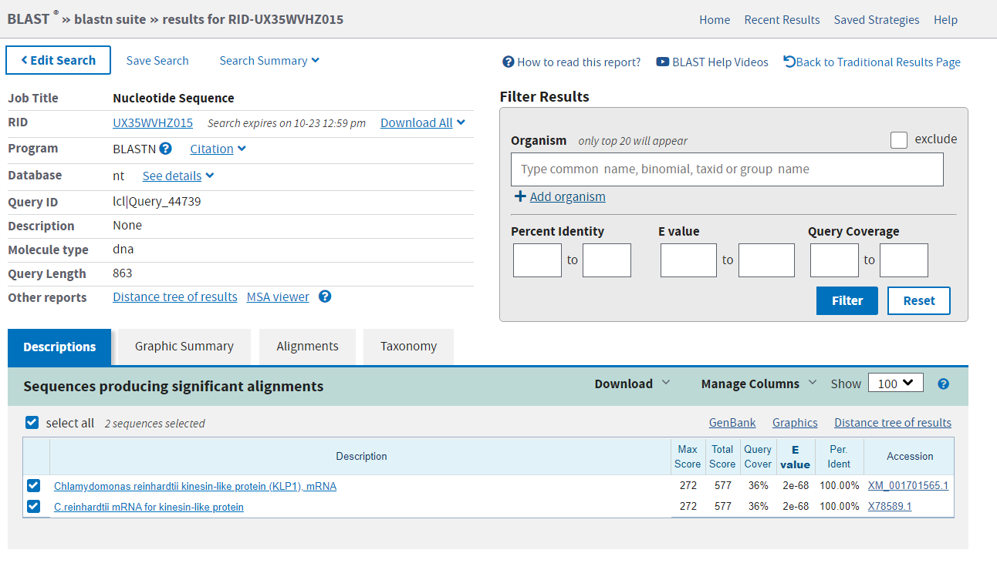
Click on accession number of the entry that has the highest percentage identity (or the one on top of the list)

Slide 21
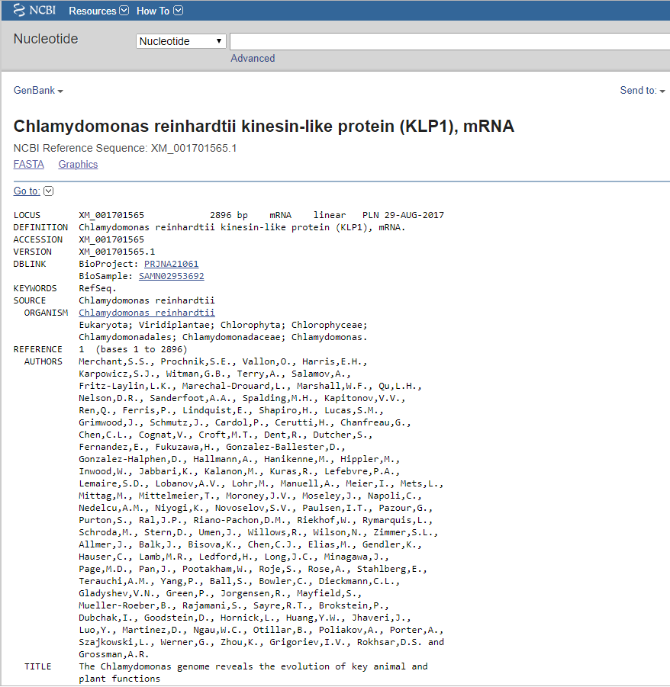
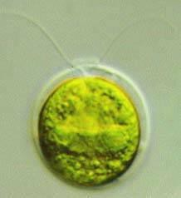

Slide 22
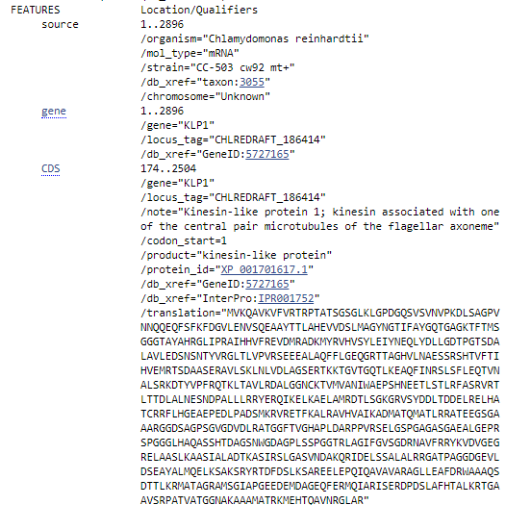
Click on CDS to bring up the coding sequence

Slide 23
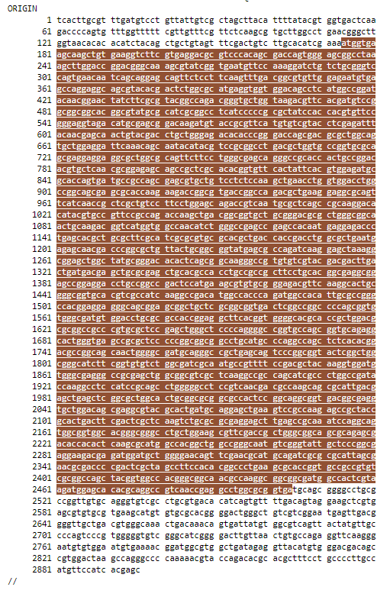
When you click on CDS, it will highlight the coding sequence in brown, and bring up a window in the bottom right hand corner.
The region that is not highlighted is untranslated regions, such as promotor regions etc.

Slide 24
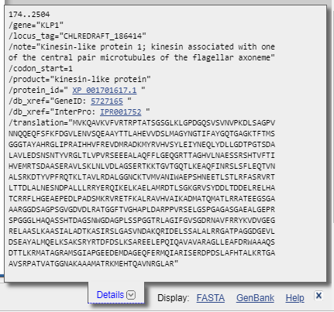
This is what the window will look like.
These are the numbers you want. This tells you the position of the nucleotides within the coding sequence.
In this example, the coding sequence starts at the 174th nucleotide, and goes to the 2504th nucleotide.

Slide 25
Results
In the description page it should give you
Name of the organism
Reference to the published paper about the gene
Name of the Gene
Number of nucleotides and amino acids for the gene
You should be able to use this information to complete the assignment, but you may have to research what the genes do

